Slide 1
Heart Health Status
CONTINUE
Here is where your presentation begins

Slide 2
CONTENTS OF The Presentation
PREV
NEXT
Here’s what you’ll find in this Slidesgo template:
First Understanding Data: A) understnad the columns B) Check the data types C) Describe Num colu
Extract New Features
EDA a) UNIANALYSIS b)BIANALYSIS c) MULTI
Pre-Processing a)Detect and Handle Duplicates. B) Train test split. C) Detect and Handle NANS D) Detect and handle outliers E) Encoding F) Imbalanced G) Scaling
Save the Train and Test in the new CSV

Slide 3
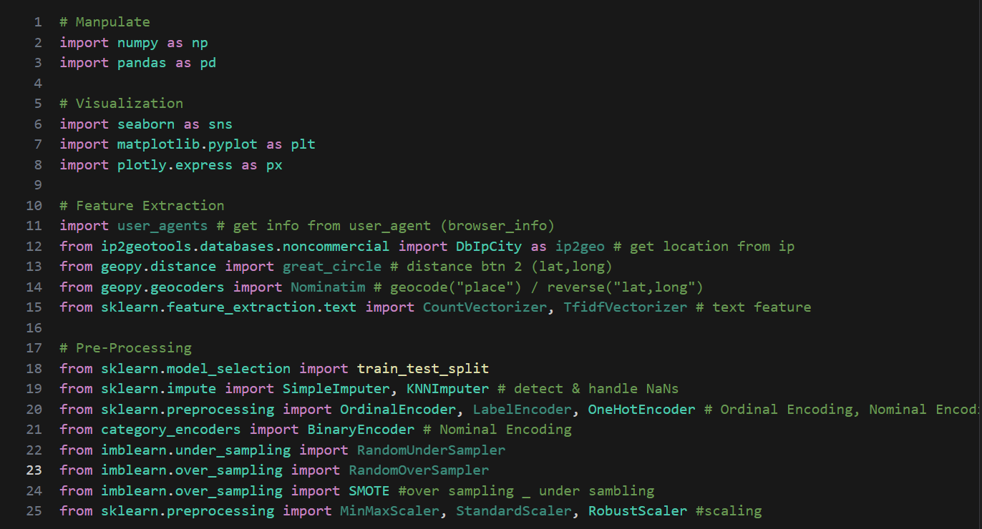
Import libraries

Slide 4
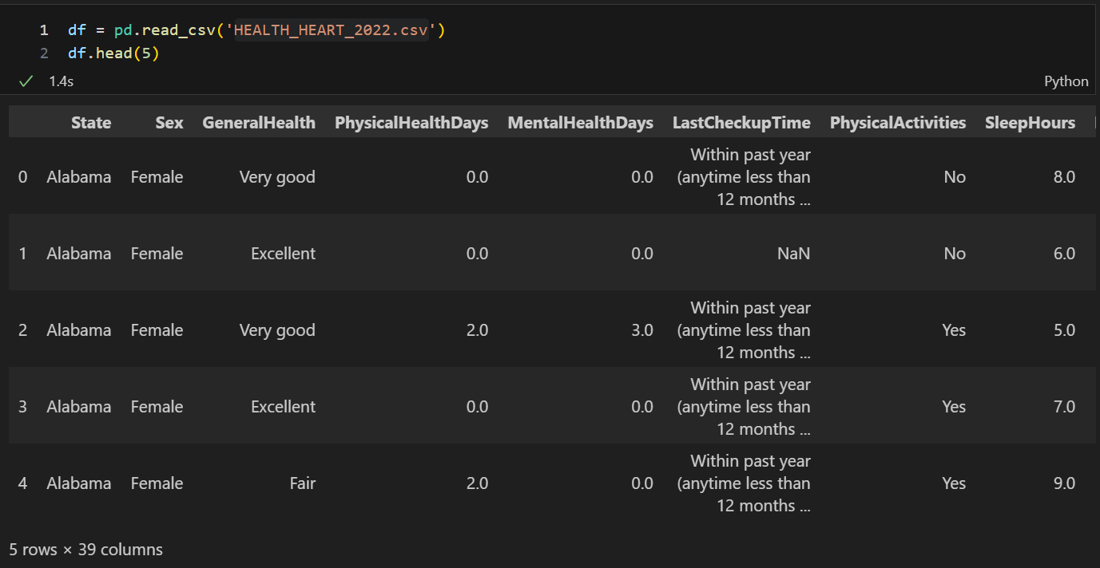
First: read the csv using pandas

Slide 5
1
Now : We start Understanding the data
PREV
NEXT

Slide 6
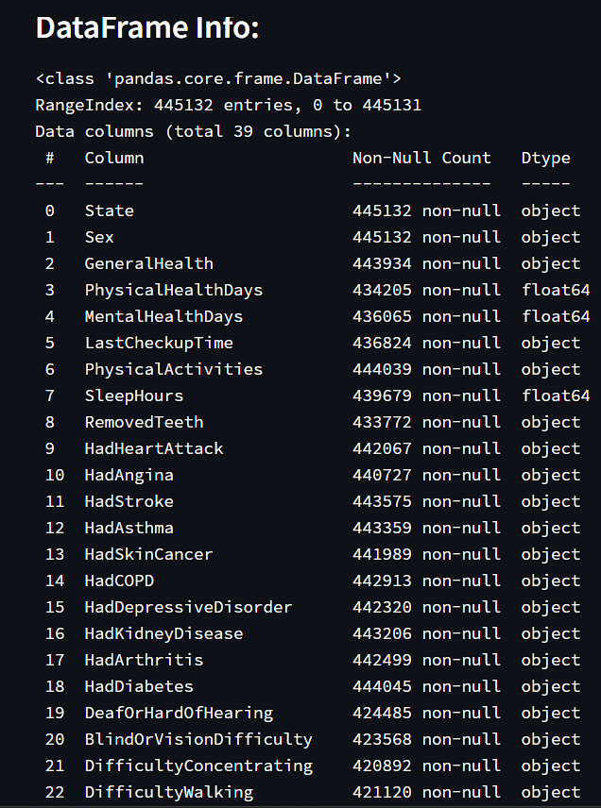
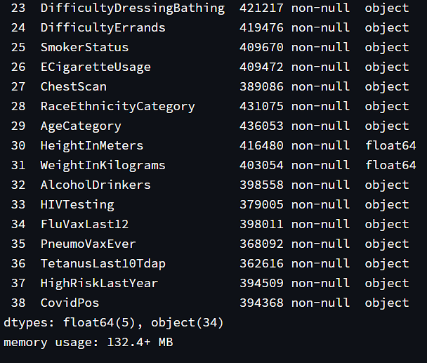
No data need to change there data type and there is nans in the columns

Slide 7
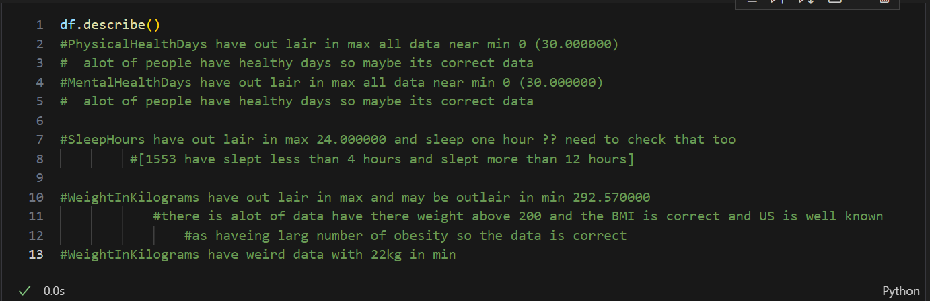
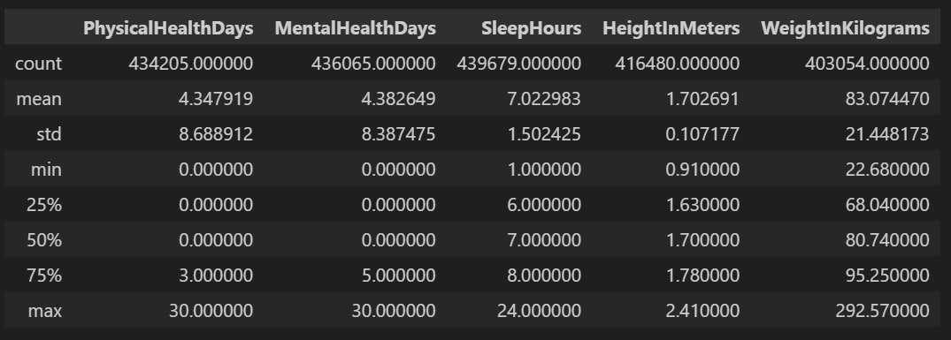

Slide 8
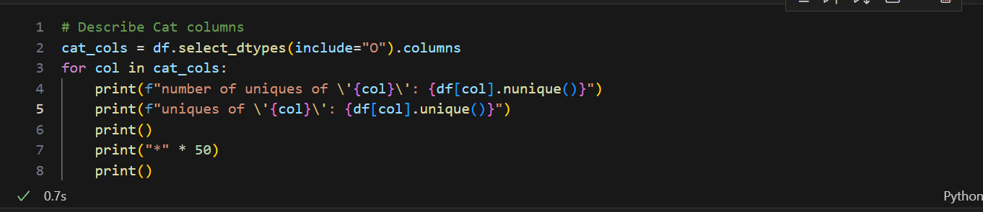
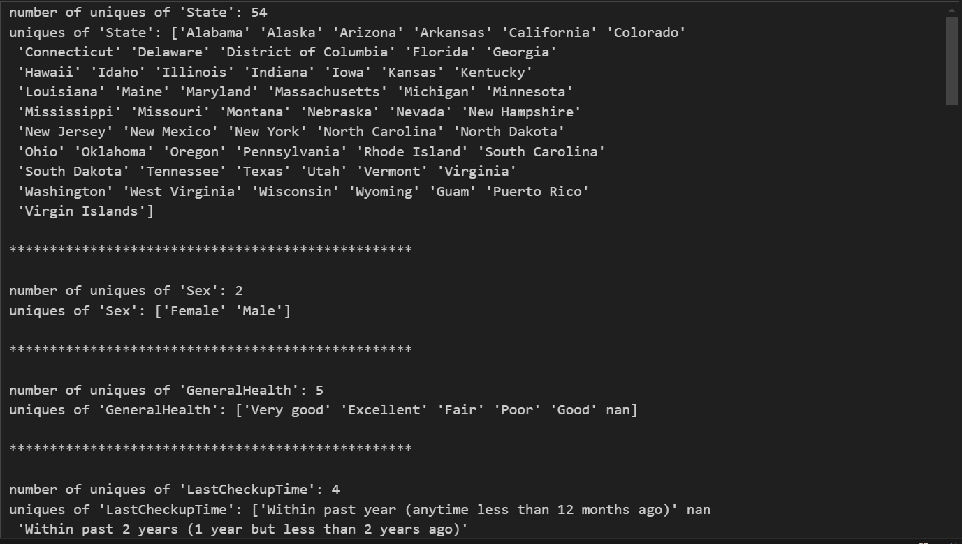

Slide 9
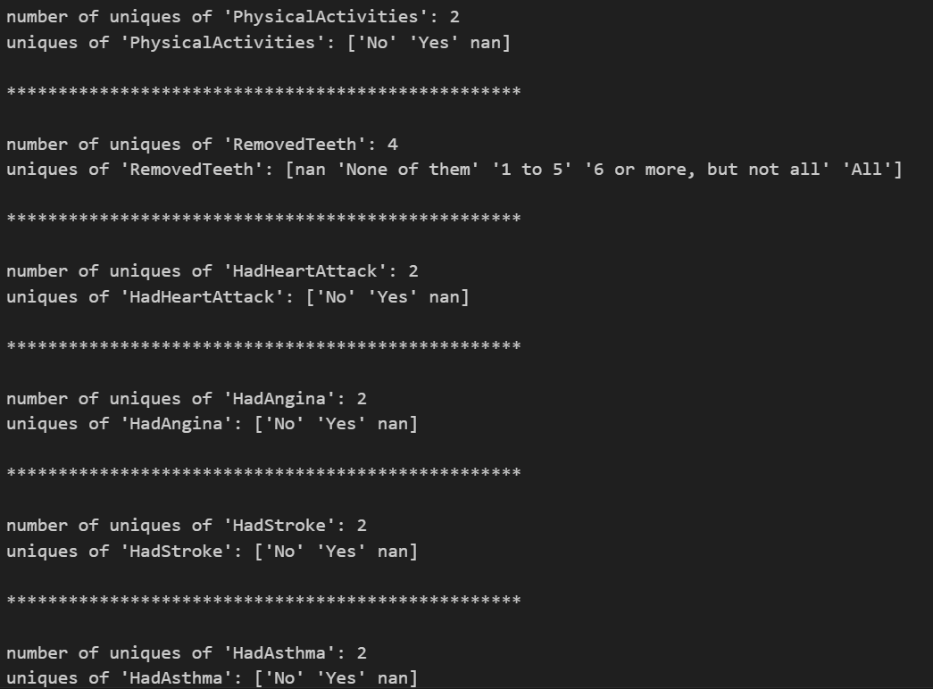
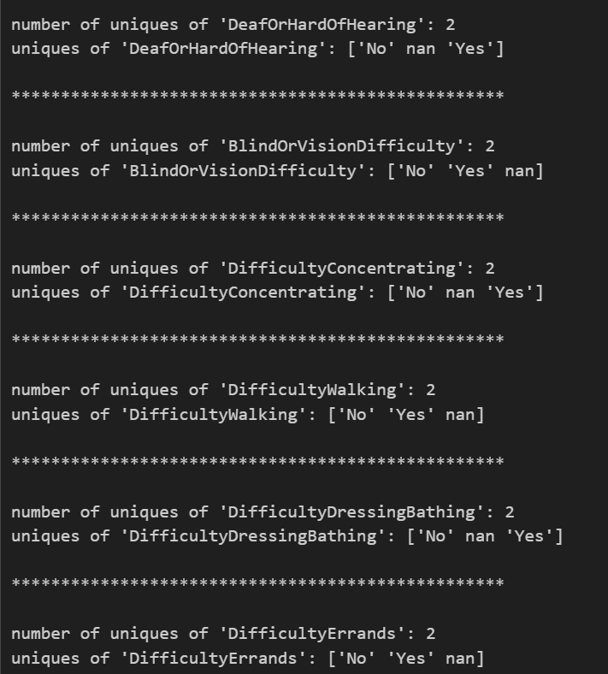
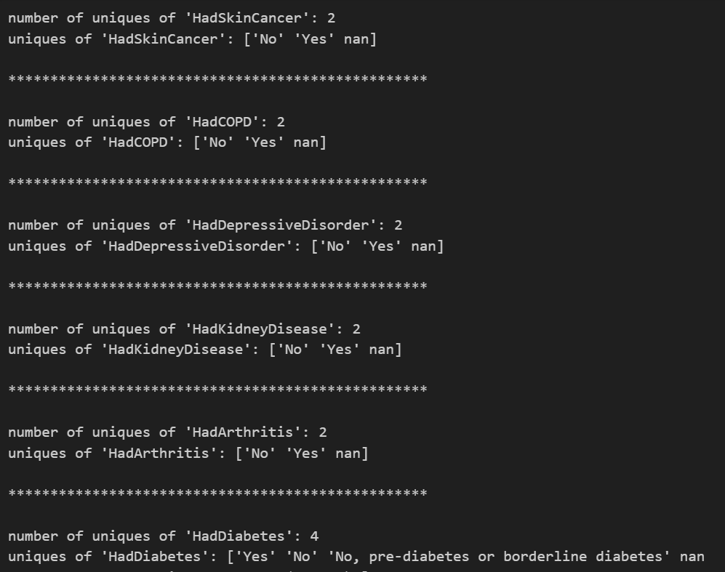

Slide 10
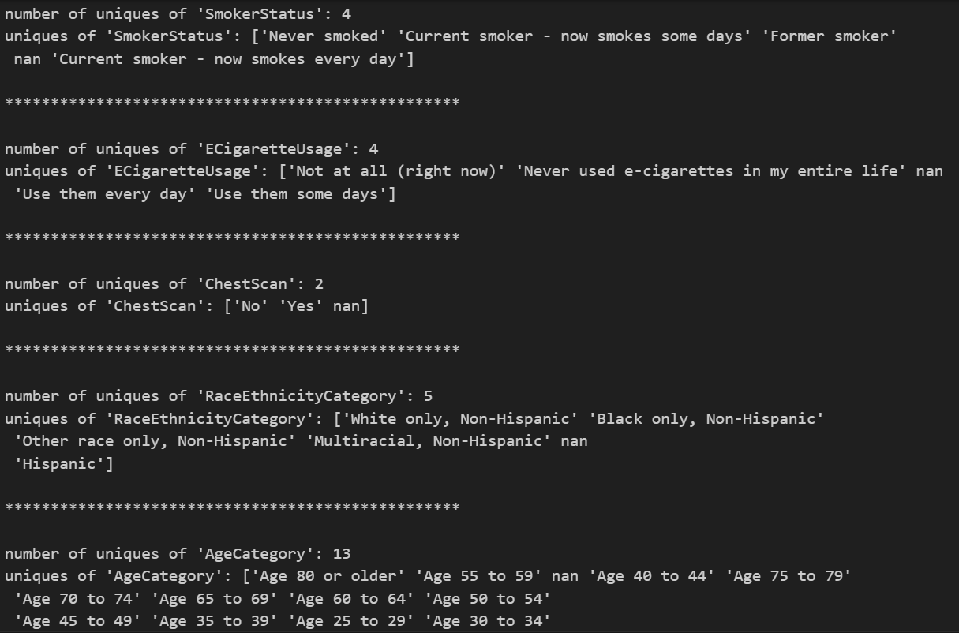
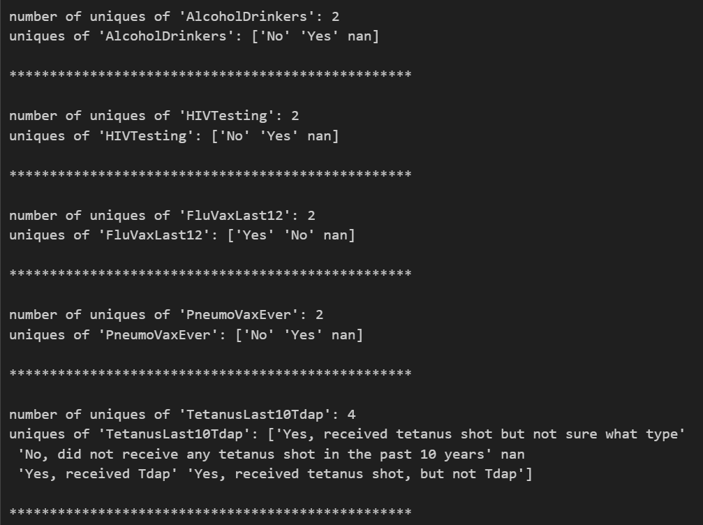

Slide 11
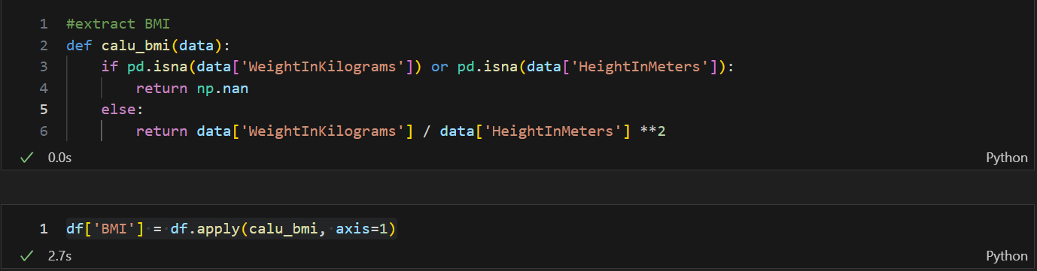
Extract New Features
Extract BMI

Slide 12
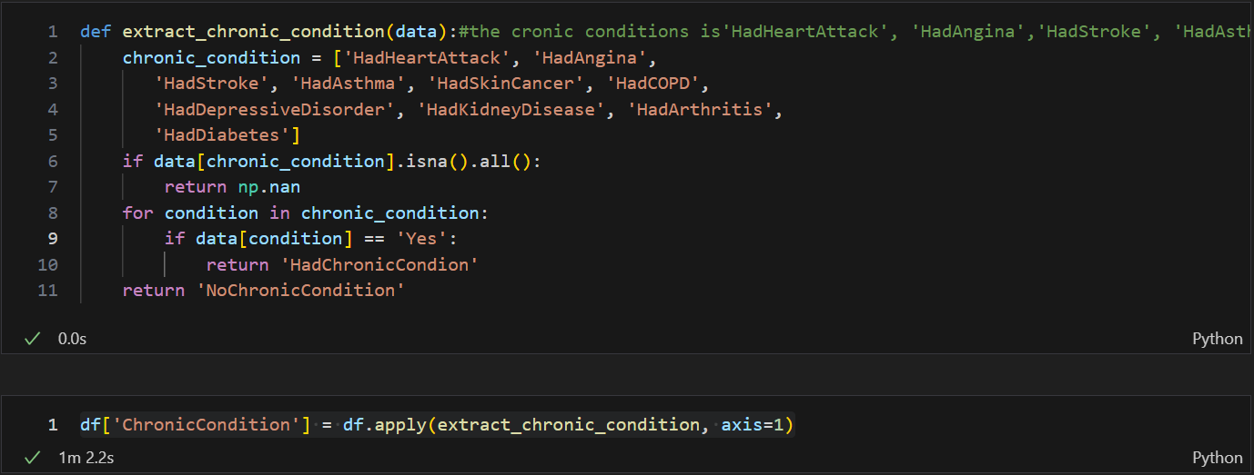
Extract chronic Conditions

Slide 13
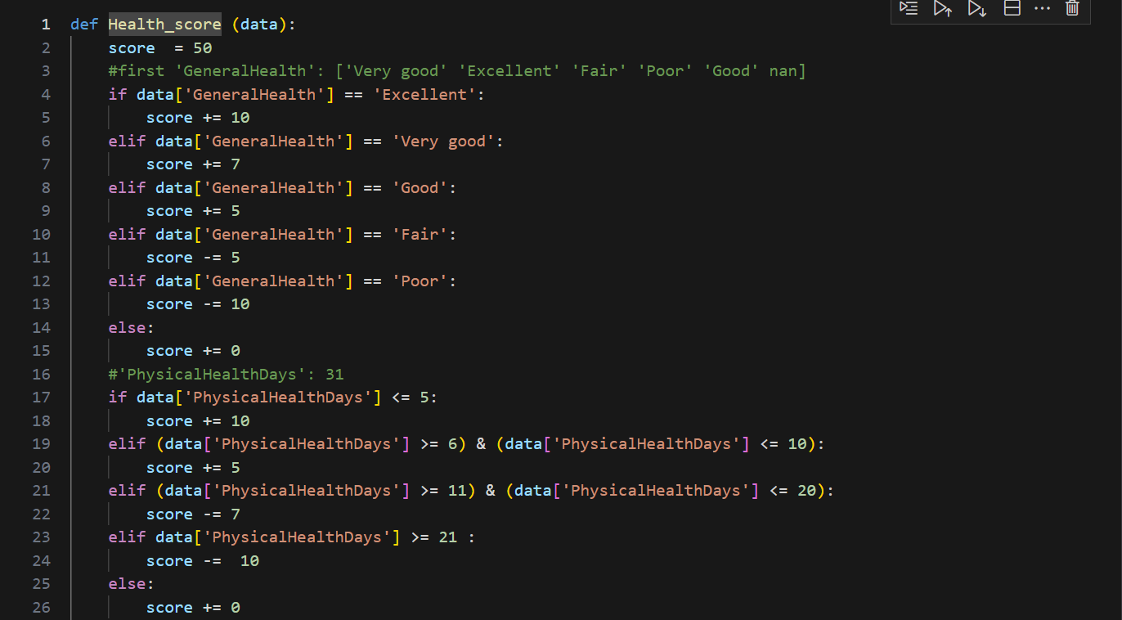
Extract Health Score

Slide 14

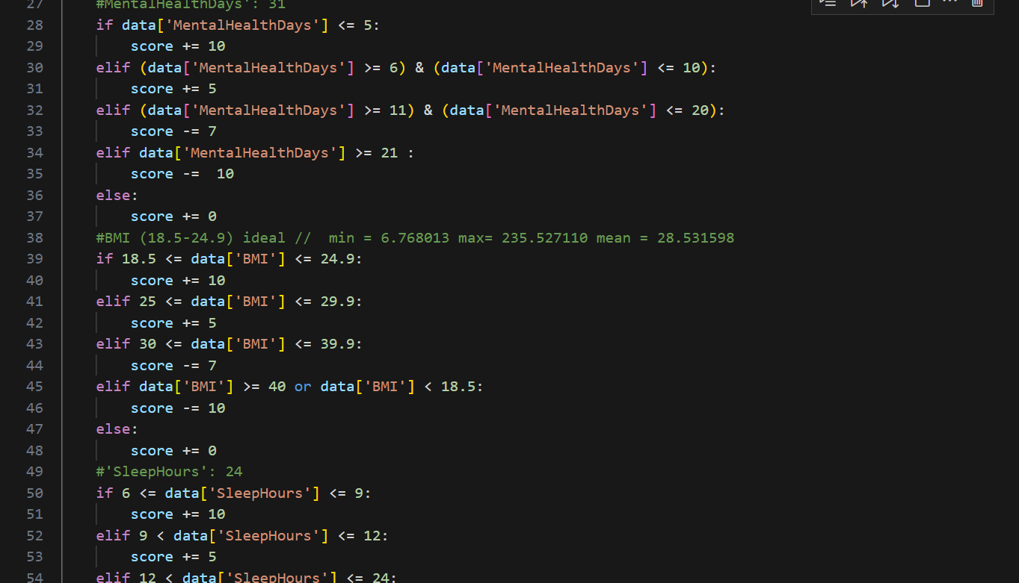
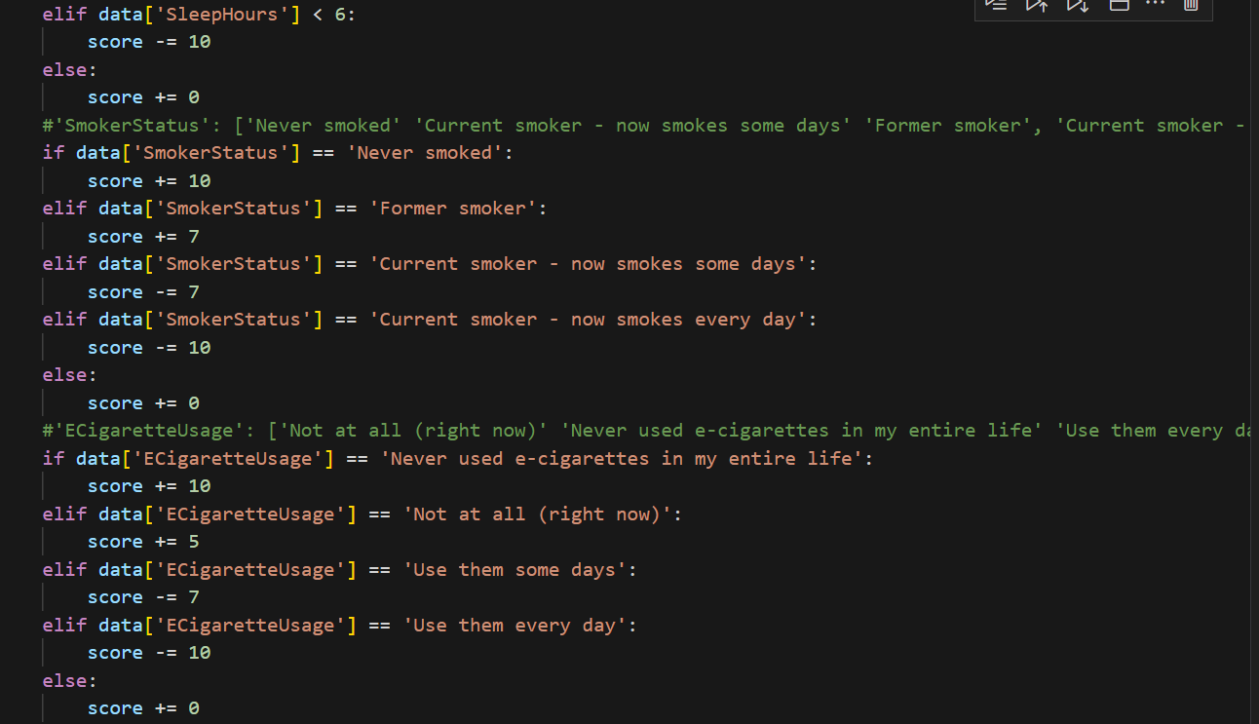

Slide 15
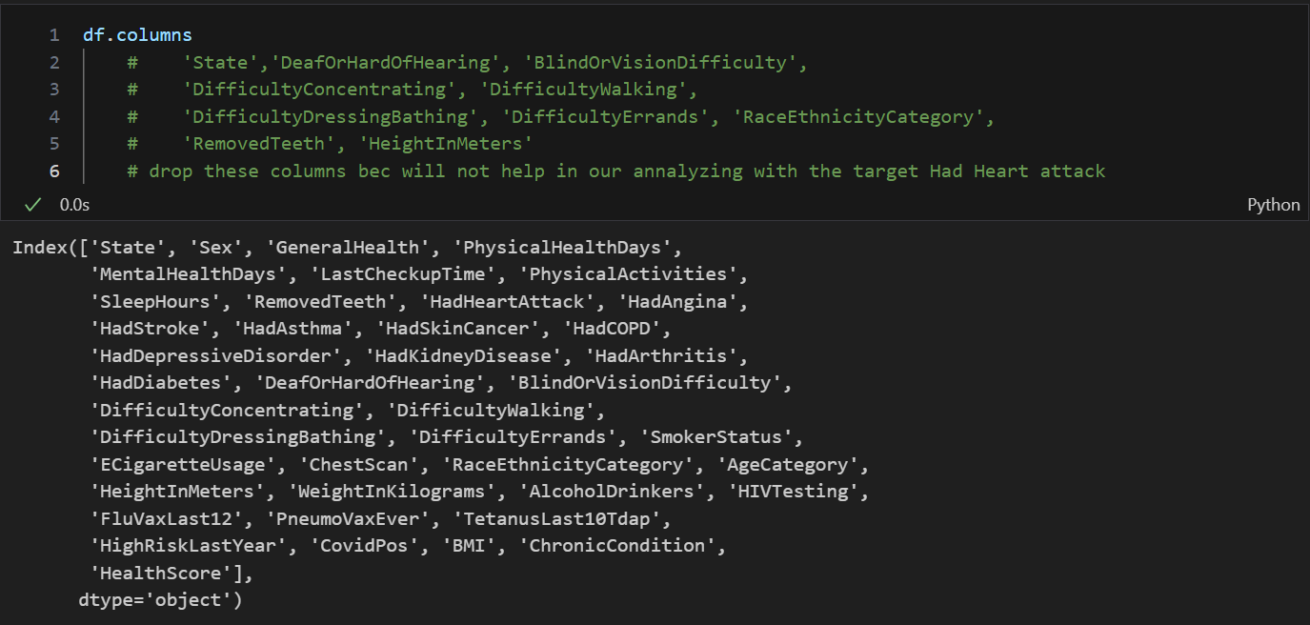
Drop unnecessery columns

Slide 16
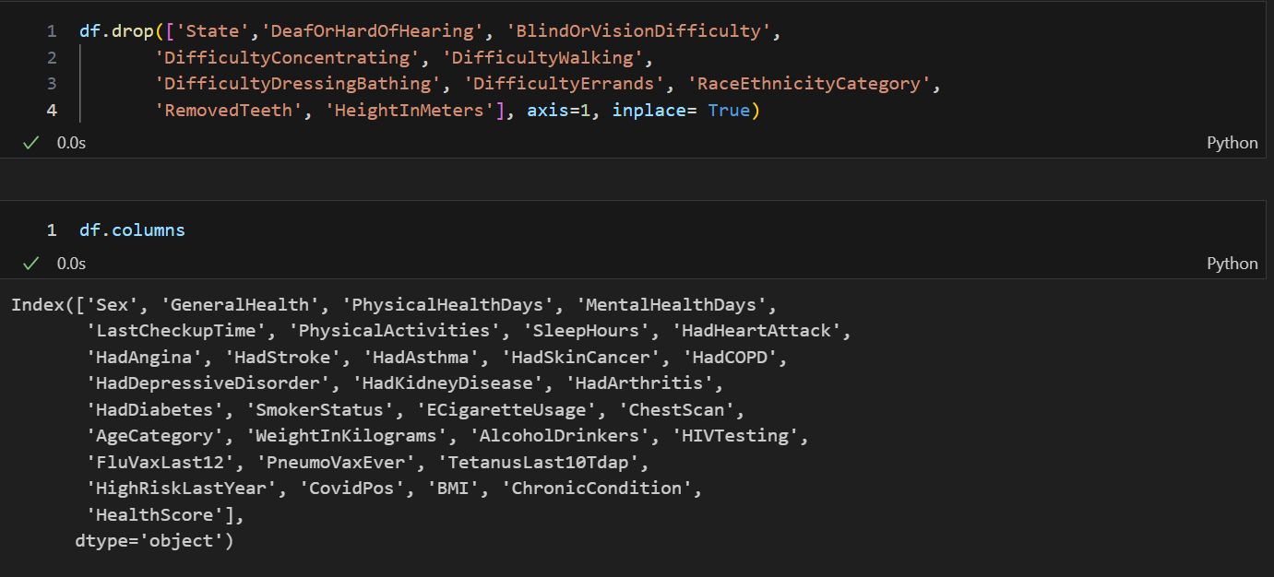

Slide 17
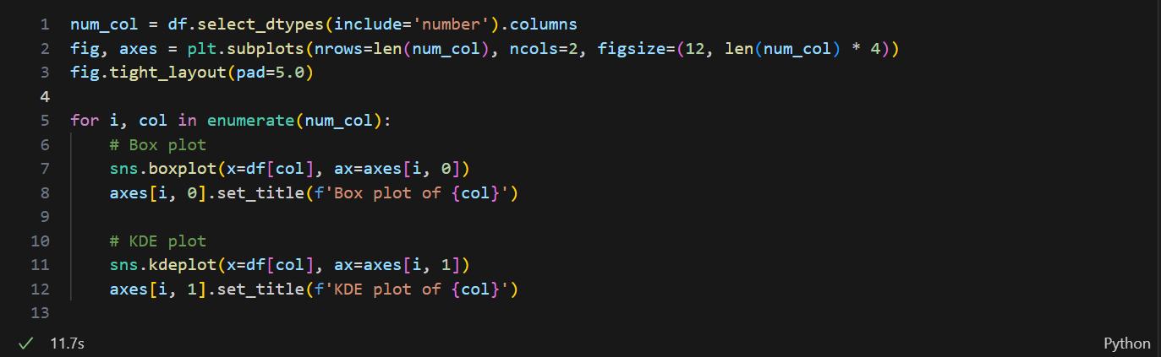
Univariate analysis

Slide 18
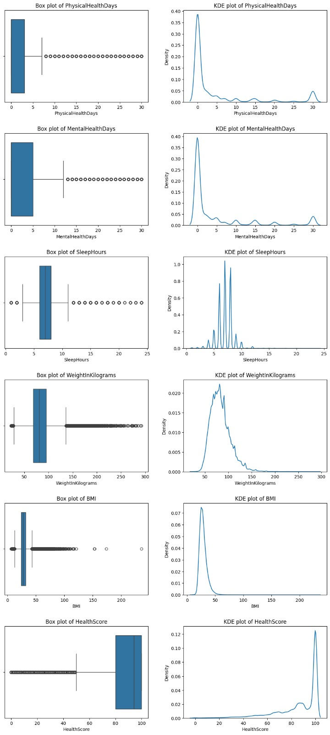

Slide 19
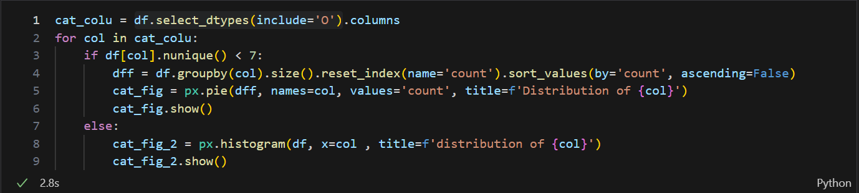
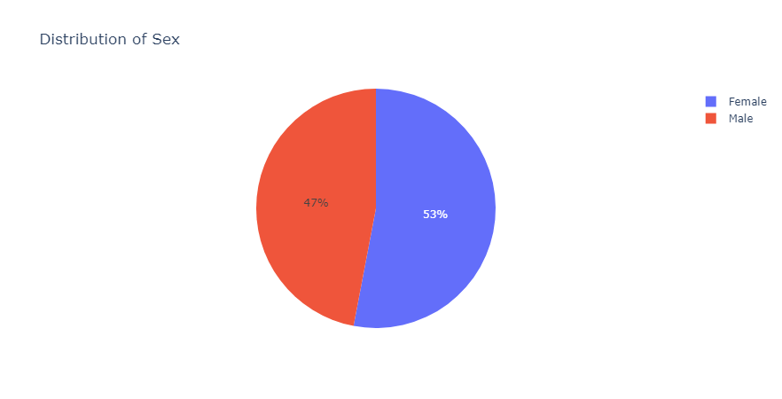

Slide 20
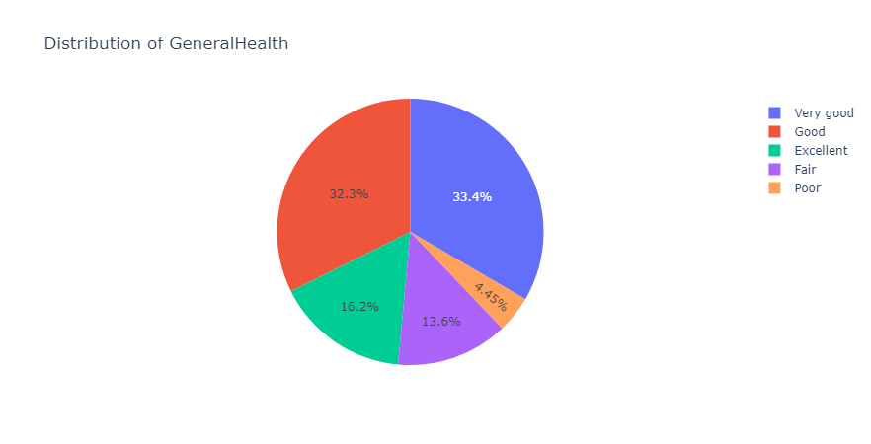
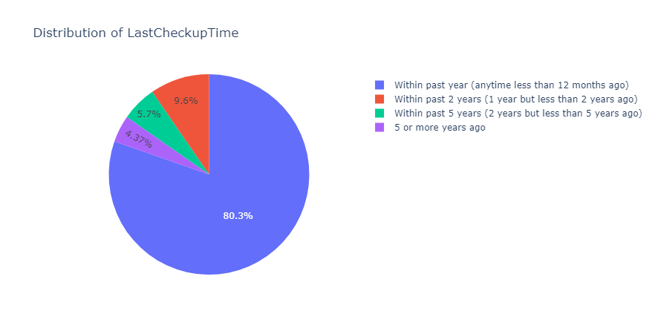

Slide 21
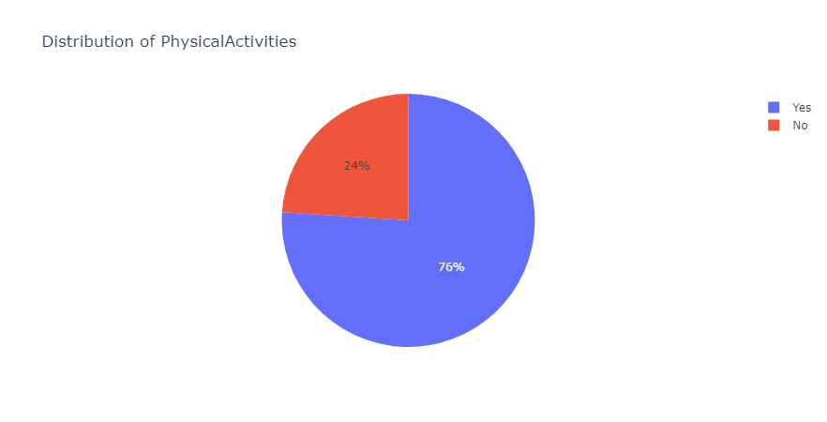
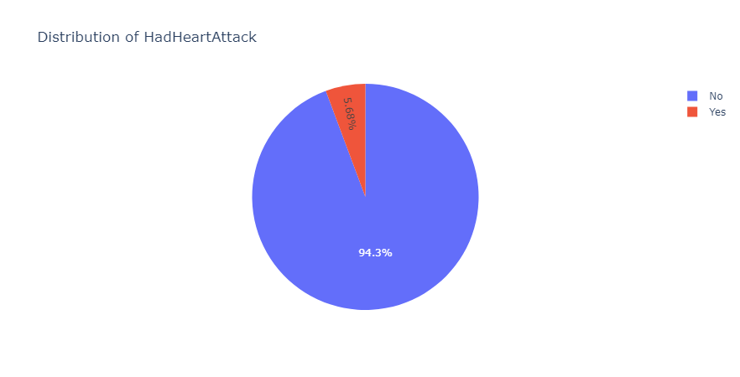

Slide 22
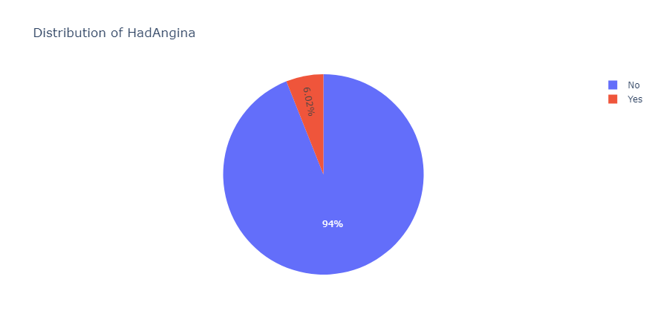
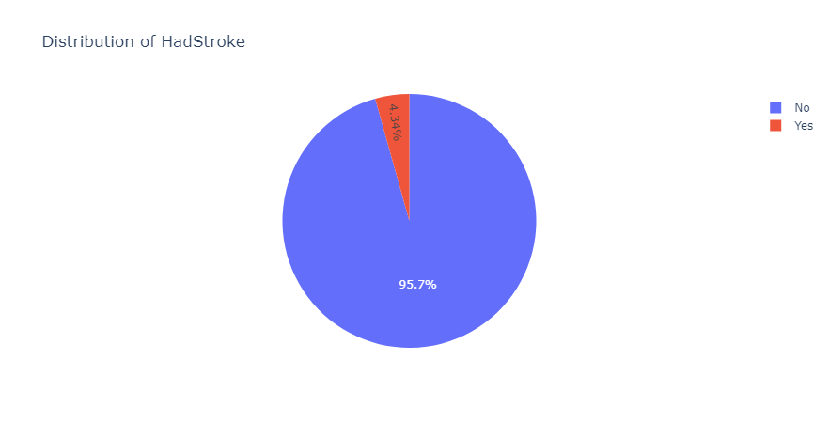

Slide 23
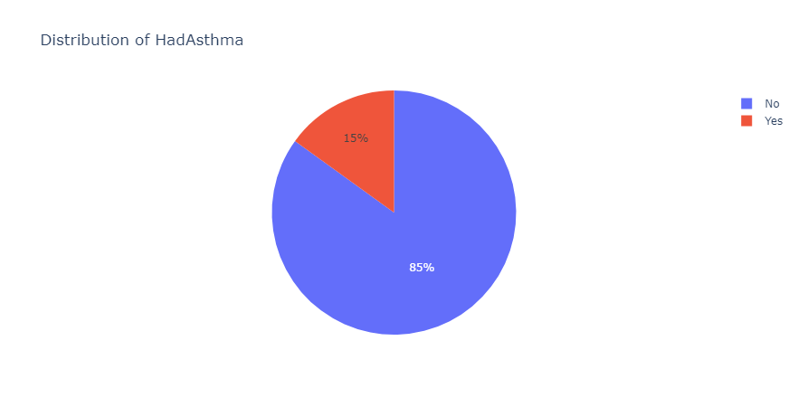


Slide 24



Slide 25
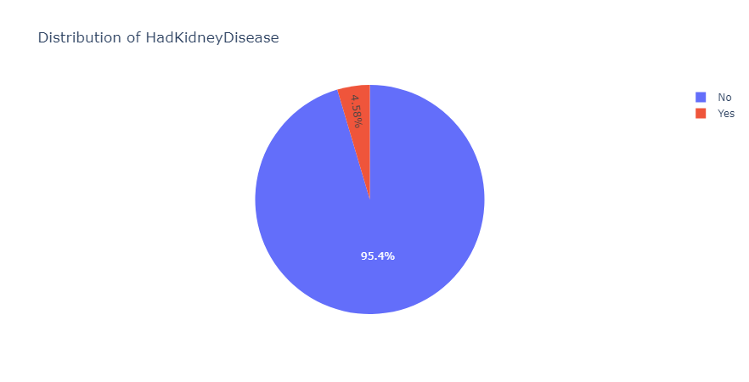
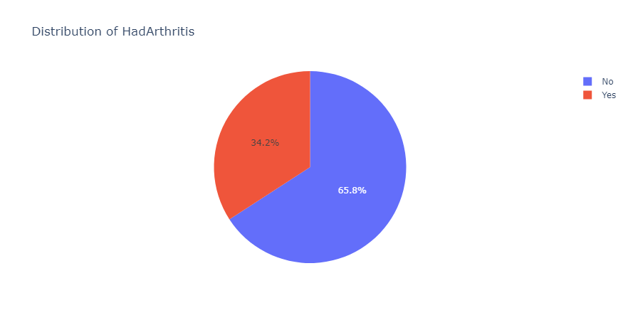

Slide 26
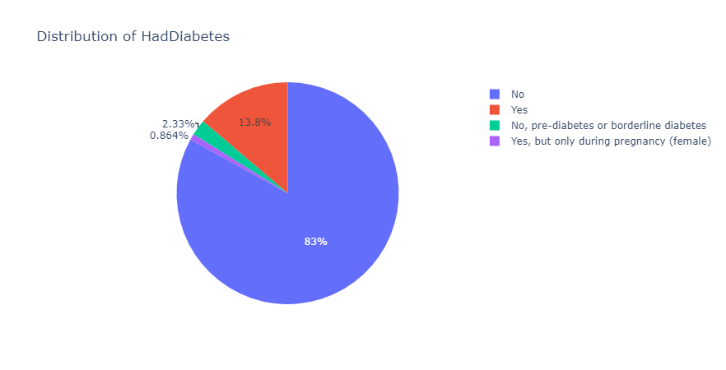
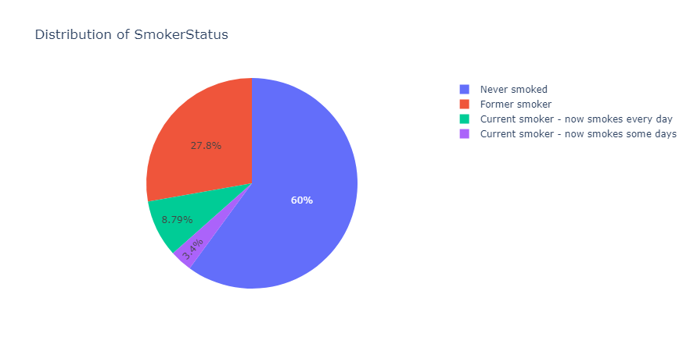

Slide 27
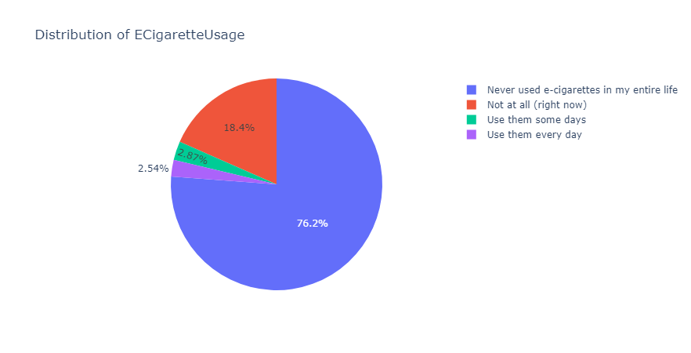
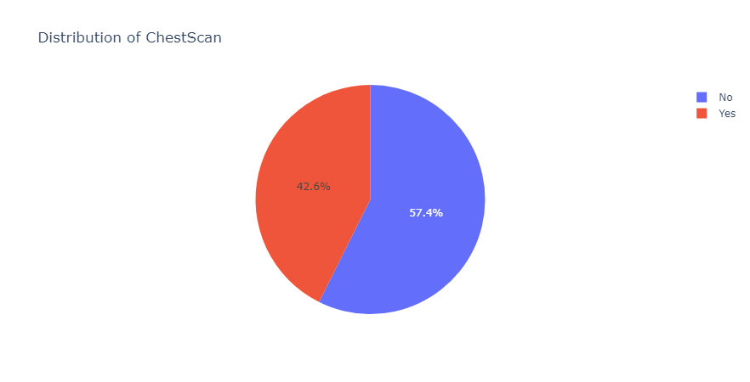

Slide 28
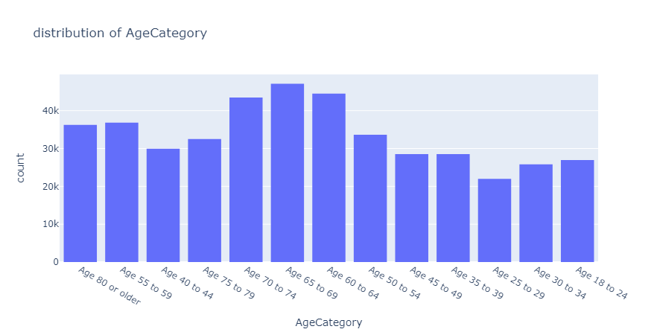
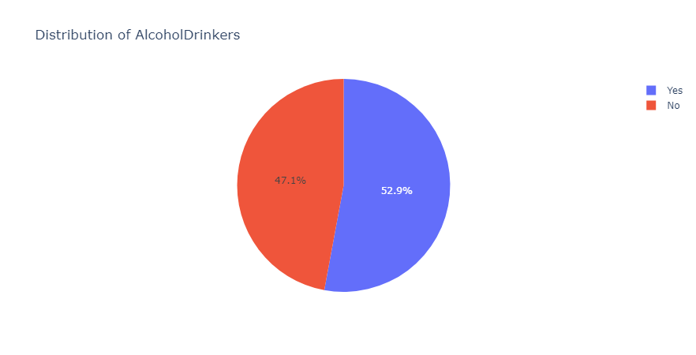

Slide 29



Slide 30
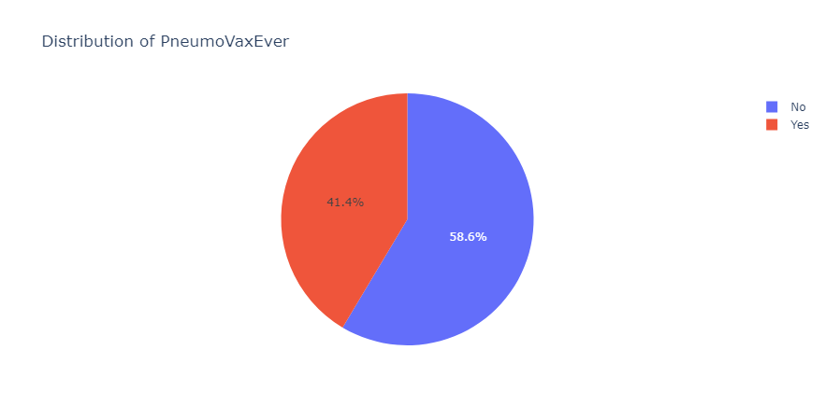
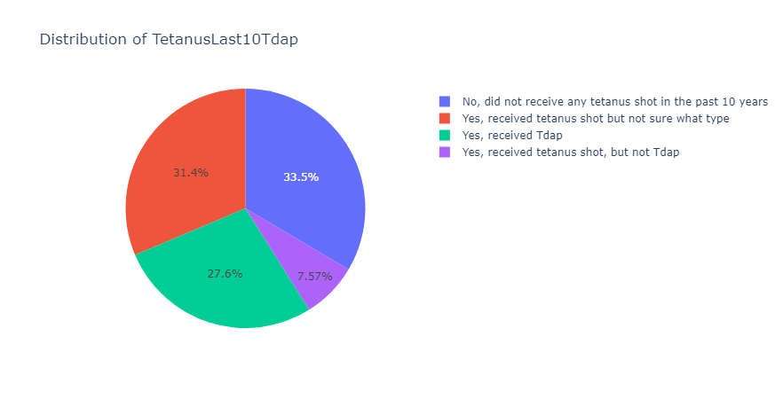

Slide 31
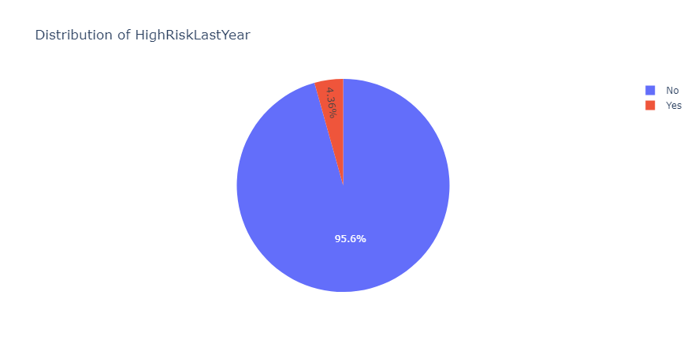
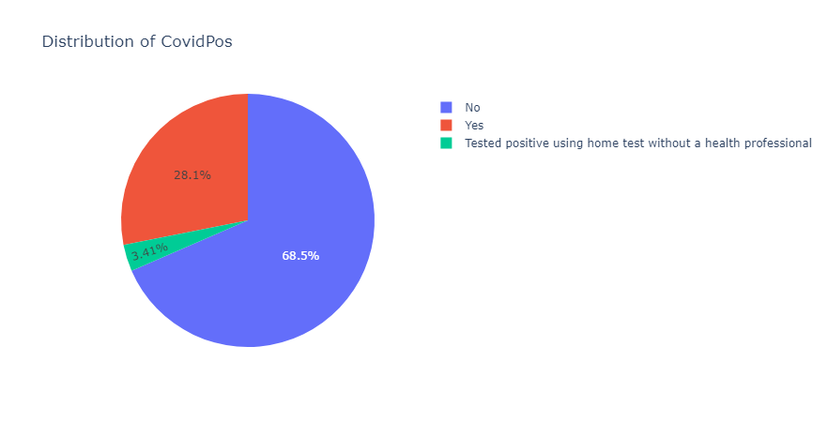

Slide 32
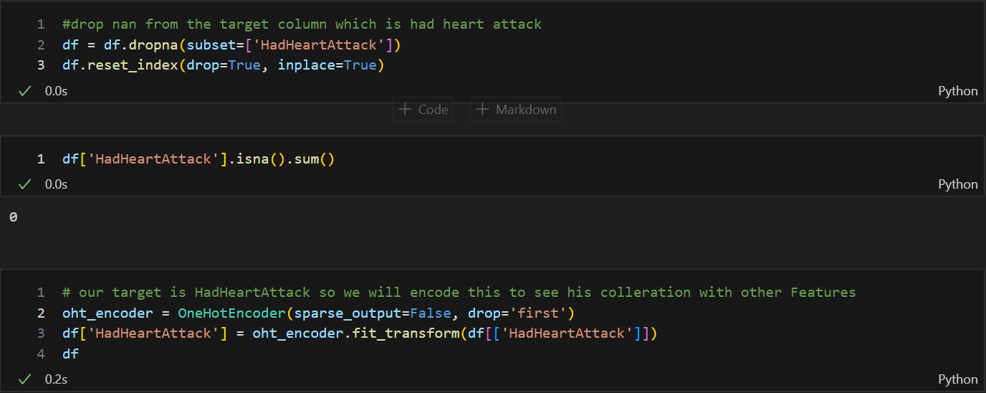
Bivariate analysis but first we need to drop nans and encode the target column to see its corr with other features

Slide 33
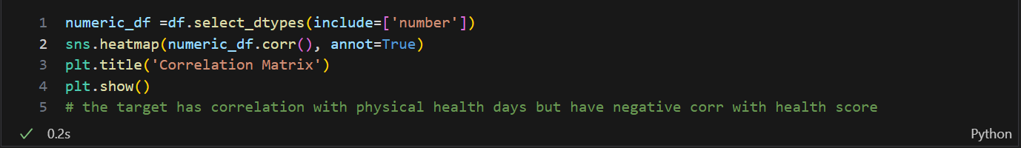
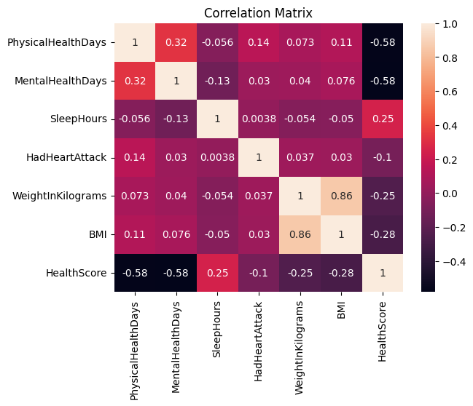

Slide 34
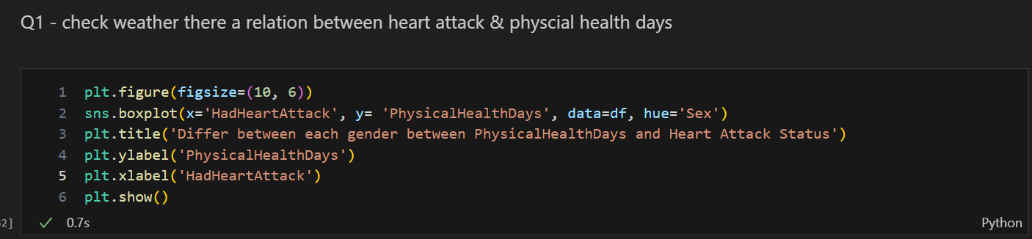
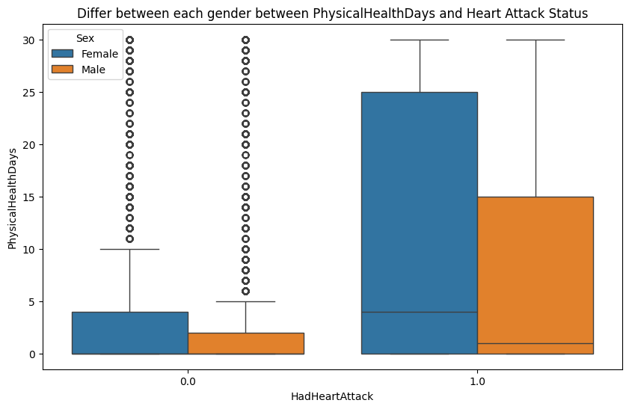

Slide 35
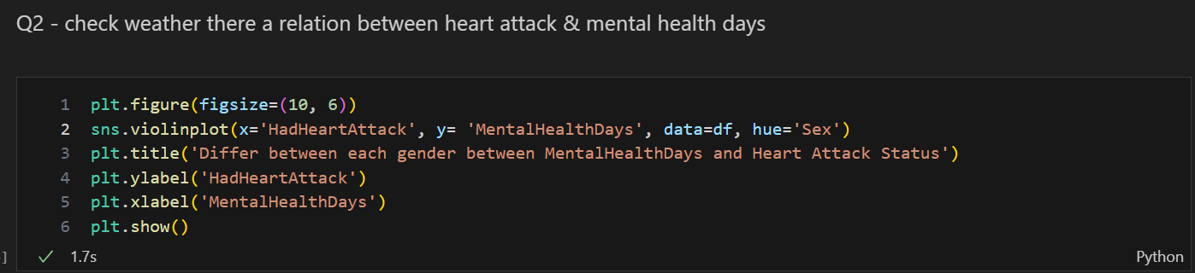
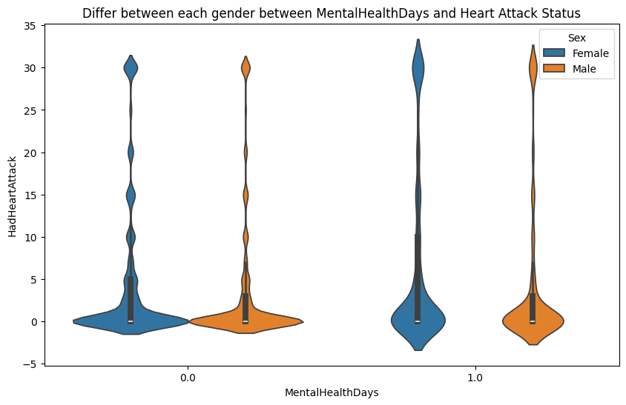

Slide 36



Slide 37



Slide 38



Slide 39



Slide 40



Slide 41



Slide 42



Slide 43



Slide 44



Slide 45



Slide 46



Slide 47



Slide 48



Slide 49



Slide 50



Slide 51



Slide 52


Multi analysis

Slide 53

Pre_processing first step is detect and handle duplicates

Slide 54

Second is train test split

Slide 55


Third step: is detect and handle nans detect by function

Slide 56


This code drops the rows that have 10 or more nans and keep the index of the reset then handle the num columns

Slide 57


Then handle the nans of the cat columns

Slide 58


Slide 59

Encoding Columns

Slide 60



Slide 61



Slide 62


Slide 63

Concat the encoded columns and Drop the old columns

Slide 64


Slide 65


Slide 66



Slide 67


Slide 68


Slide 69


Slide 70
Thank you for your patient
I hope u like this presentation
don’t forget to check the links below
https://github.com/mostafa-s-mostafa/Mid-Project https://github.com/mostafa-s-mostafa/Mid-Project-Deployment https://mid-project-deployment-mostafa.streamlit.app/Analyzing

